Slide 1
Figurative Language in Discourse Analysis
DIONE mini-collaboration
Ana Kuzmanović Jovanović, University of Belgrade, ana.kuzmanovic@gmail.com
Marija Mandić, University of Belgrade, marija.mandic@ifdt.bg.ac.rs
Ljiljana Šarić, University of Oslo, ljiljana.saric@ilos.uio.no

Slide 2
Paper I: Koteyko, Nelya & Ryazanova-Clarke, Lara. (2009). The Path and Building Metaphors in the Speeches of Vladimir Putin: Back to the Future?. Slavonica 15: 112-127.
Paper II: Taylor, Charlotte. (2021). Metaphors of migration over time. Discourse and society 32(4): 463-481.
Paper III: Šarić, Ljiljana (2019). How to do things with metaphors: The prison of nations metaphor in South Slavic online sources. In Mateusz-Milan Stanojević, Ljiljana Šarić eds., Metaphor, Nations and Discourse, 287–321, John Benjamins.
In this presentation, we have chosen to present three papers that analyze figurative language use in public and political discourse as examples of good practice that demonstrate:
How to recognize the topic and problem?
What is the social relevance of this research?
How to pose research questions?
How to use different theories and methods for analysis?
How to create a corpus and select data for analysis?
How to perform the analysis?
What conclusions can be drawn?
How to connect research findings with wider social context and social responsibility?

Slide 3
Koteyko, Nelya & Ryazanova-Clarke, Lara. (2009). The Path and Building Metaphors in the Speeches of Vladimir Putin: Back to the Future? Slavonica 15: 112-127.
Topic and Problem
  A critical exploration is provided of the path and building metaphors used in the speeches of the Russian president Vladimir Putin. Critical metaphor analysis enables us to identify which metaphors are chosen and to explain why these metaphors are chosen by illustrating how they create political myths
Relevance
  Putin’s use of two metaphors are explored as part of his legitimization strategies, since metaphors in public discourse use stereotypical representations of everyday situations to provide evaluative perspectives on contested topics as well as to legitimize political actions.

Slide 4
Research Questions
  How the Russian president made use of the above two metaphors as part of his legitimization strategies? What ideological patterns of metaphor use are being established?
Theory and Methodology
  The concepts of ‘discourse metaphor’ and ‘frame’ are used in the analysis of a corpus of Putin’s speeches written and delivered between 2000 and 2007 in order to reveal the rhetorical strategies employed in them, and establish the ideological patterns of metaphor use.
  Discourse metaphors — metaphors that are conceptually grounded but whose meaning is also shaped by their use at a given time and in the context of a debate about a certain topic.
  The metaphors are identified, analyzed according to source domains, and then explored for their contribution to the overall project of the Russian president.

Slide 5
Data
  A corpus of Putin’s public speeches (total word count — 210,000) have been collected on the basis of texts downloaded from the President’s website www. kremlin.ru. Only monologic texts were included. The data comprise of speeches and addresses delivered at a broad variety of venues such as congresses, conferences, opening and award ceremonies and those that are the prerogative of only the President.
  A qualitative analysis of the corpus contexts was carried out in order to decide whether each use of a keyword is metaphoric or literal. At this stage, corpus-based techniques such as concordances and collocational profiles were used.

Slide 6
Discussion
  PATH METAPHOR: A conceptual metaphor that is most obviously and frequently exploited in Putin’s speeches.It denotes a successful activity in moving forwards, so it presents ’following a path’ as making progress;
  But also ’following a path’ is presented as meeting a challenge (where ‘path’ emphasizes the effort required to reach a political goal)
  The use of the path metaphor also allows the President to evaluate events negatively and to frame negatively the decade of the 1990s — i.e. the period immediately preceding his term in power.

Slide 7
  Out of 122 instances of its use in the corpus, the noun ’path’ co-occurs 63 times with the lexis from the ‘economy set’ (mostly in ‘economic development’), 12 times with lexical items denoting various ‘difficulties’, and only 5 times with words ’democratic’ and ’statehood’.
  The emphasis on the development of economic liberties is indicative of the discourse of neoliberalism, from which Putin borrows extensively.

Slide 8
Но я уверен: путь, ыбранный народом России, — правильный равильный, и он приведёт нас к успеху. У нас всё для этого есть: наша великая история, колоссальные ресурсы, мужество, трудолюбие и интеллектуальный потенциал нашего великого народа. (31 December 2007)
But I am sure: the path chosen by the people of Russia is the right one, and it will lead us to success. We have everything for this: our great history, colossal resources, courage, diligence and intellectual potential of our great people. (31 December 2007)

Slide 9
  BUILDING METAPHOR: Building metaphors are often used with positive undertones as building implies coordinated human effort and, just as with the path metaphor, it means a development in a certain direction, for example in building economy, leading it on a path.
  The ideas of ‘strong’ and ‘great’ state are again evoked here, as Putin emphasizes the need either to build or, most frequently, ‘fortify’ the state apparatus. The idea of fortification suggests counteracting danger, represented by ruining of the structure.
  In this study, it can be argued that the use of path and especially building metaphors allows the president to represent himself as a dynamic agent who is ‘mythically in control of the forces of creation and destruction’.
  The study has also pointed to the high level of interdiscursivity in Putin’s texts, as he seems to appropriate elements from competing ideologies in order to win the discursive battle.

Slide 10
За десять лет мы прошли очень сложный путь, накопили уникальную практику государственного и политического строительства. Российский народ сформировал демократическую государственную власть. Механизм свободных выборов устойчиво работает на всех уровнях. Существенно укрепились основы федерализма. (7 December 2001)
For ten years we have passed a very difficult path, accumulated a unique practice state and political building construction. The Russian people formed a democratic state power. The mechanism of free elections works steadily at all levels. The foundations of federalism were strengthened substantially. (December 7, 2001)

Slide 11
  Conclusions
  Path and building metaphors were used as part of legitimization and delegitimization strategies in order to promote a two part narrative, according to which, under Boris Yeltsin the state did not govern, the economy was in ruins, and people suffered, whereas since 2000, under Putin, order and economic stability have returned, and the Russians are on the way to a prosperous future.

Slide 12
Taylor, Charlotte. (2021). Metaphors of migration over time. Discourse and society 32(4): 463-481.
Topic and problem
While extensive analyses of contemporary migration discourse, including its metaphors, have been made, we have little understanding of how longstanding certain discourse frames and metaphors are, and how they have developed over time.
This study combines corpus linguistics and (critical) discourse analysis to investigate continuity and change in conventionalised metaphorical framings of migration in the UK-based Times newspaper, from 1800 to 2018.

Slide 13
Relevance
Drawing on a corpus covering a 200-year period, it is possible to trace when metaphors became conventionalised and how they have developed.
Metaphor helps frame the world; identification of those frames can give the discourse analyst insight into the viewer’s perspective
These findings can:
  provide a background for contemporary research
  enable insight into the extent to which contemporary metaphors are inherited

Slide 14
Research questions
Which conventional metaphors of migration are recent, and which are long-standing?
How favourable was the evaluation of migrants in the dominant conventional metaphors?
How are historical data relevant for analyses of metaphors in contemporary data?
What is the number of lexicalisations for each of the conventional metaphors identified?
Which migrant-related words (e.g., expats, refugees) do the conventional metaphors identified (e.g. liquid, object) collocate with?

Slide 15
Theory and methodology
The study combines corpus linguistics’ and (critical) discourse analysis’ methods and applies them to a historical corpus.
It focuses on conventionalised conceptual metaphors.
Conceptual metaphor is defined as a cumulative phenomenon – it emerges when the concept is lexicalised multiple times (e.g. migrants are guests: host country, reception centre)
In determining whether a metaphor was conventionalised, the author followed the rule that there should be at leat two lexicalisations (e.g. wave, flood) per methapor category (e.g. migrants are liquid) per decade.

Slide 16
Data
The main corpus used: the Times online corpus created at Lancaster University; it covers the period 1785-2011 and its current size is c. 10.5 billion words. It was supplemented by a search-term corpus covering the period 2012-2018 compiled from the Times archive (c.19 million words)
The process of corpus analysis:
  Collocates were calculated for node items (aliens, asylum seekers, boat poepe, colonists, emigres, emigrants, evacuees, expats, expatriates, immigrants, migrants, refugees, settlers) in each decade of the corpus.
    Collocates: items with a strong connection with a node (e.g., immigrant and wave)
  The collocates were then searched for metaphorical candidates (scanning the collocate lists, using dictionaries, reading concordance lines).
  Sample concordance lines for each metaphor candidate for each time period were checked for metaphor use and coded according to the lexicalisation of the metaphor and evaluation.
  Once a metaphor had been identified, the collocate (e.g., wave) was moved to the node position and its collocates were searched, per decade.

Slide 17
Collocates of emigrants
1800 | 1850 | 1900 | 1950 | 2000
French | intending | intending | AUSTRALIA | Slawomir
Lift | carry | young | to | Irish
the | Australia | number | CANADA | the
of | to | Canada | FROM | of
France | number | out-patients | intending | revealing
who | for | SENT | Zealand | Returning
returned | vessels | attending | countries | from
are | from | Information | Britain | America
country | The | of | FLOW | play
return | of | British | for | Jewish
to | out | seeking | would-be | to
from | sailed | Hospitals | fares | Russian
all | sent | from | remittances | Italian
that | Irish | are | Jewish | nation
were | who | out | British | British
Notes:
50-yr sample
General point > not all people from UK e.g. France in 1800 > Britain only moves up the saliency list in later time periods
Shift to historical focus e.g. Jewish & Irish
NB sent in 1850 & 1900 > see eg

Slide 18
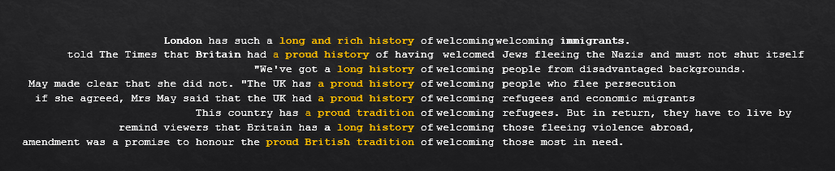
Concordance lines

Slide 19
Discussion
The migrants are liquid metaphor was found in conventionalised form from 1850 onwards. It collocated with settlers, emigrants, migrants, immigrants, refugees and asylum seekers. The number of lexicalisations increased over time. The greatest number of favourable evaluations is found in the earliest timeperiod (1850-1859). The lowest number of favorable evalutions is found in the most recent period (2000-2018).
migrants are objects/commodity metaphors were found across the whole time period occuring with reference to settlers, emigrants, immigrants and refugees. Quite consistent in the number and type of lexicalisations (carry, removal). The evaluation of migrants changed from favourable or neutral to negative in the later time period.
animal metaphors were found in conventionalised form in the 1920, 1930 and 2010 subcorpora with a limited number of lexicalisations (e.g., swarms, flocking), and they collocated only with refugees up to 2010. The evaluation is largely negative.
The invader or enemy metaphor is recent as a conventionalised metaphor, with restricted lexicalisations (e.g., invasion). Negative evaluation. It only collocated with refugees and immigrants.

Slide 20
Discussion
The weight/burden metaphor occurs in conventionalised form in just two decades (1980, 2010) with two lexicalisations (strain, burden) and is used only with reference to refugees and migrants. It occured with a negative evaluation in which migrants were framed in mainly economic terms.
The migrants are guests metaphor shows signs of conventionalisation with two lexicalistions in 1920, 1930, 1950 subcorpora and then a break to 2000; richer lexicalisations appear in the 2010s. It collocates with migrants and asylum seekers. In the earlier periods, migrants were favourably evaluated; in more recent patterns, the metaphor migrants are unwelcome guests is frequently found.

Slide 21
Guest
1800 | 1810 | 1820 | 1830 | 1840 | 1850 | 1860 | 1870 | 1880 | 1890 | 1900 | 1910 | 1920 | 1930 | 1940 | 1950 | 1960 | 1970 | 1980 | 1990 | 2000 | 2010
 |  |  |  |  |  | invited | invited |  | welcome |  | Welcome | Welcome invited | guest reception Welcome invited |  | welcome invited | invited |  |  |  | welcome invited | host hosting overstay reception welcome welcomed Welcoming invited
London has such a long and rich history of | welcoming | welcoming immigrants.
told The Times that Britain had a proud history of having | welcomed | Jews fleeing the Nazis and must not shut itself
"We've got a long history of | welcoming | people from disadvantaged backgrounds.
May made clear that she did not. "The UK has a proud history of | welcoming | people who flee persecution
if she agreed, Mrs May said that the UK had a proud history of | welcoming | refugees and economic migrants
This country has a proud tradition of | welcoming | refugees. But in return, they have to live by
remind viewers that Britain has a long history of | welcoming | those fleeing violence abroad,
amendment was a promise to honour the proud British tradition of | welcoming | those most in need.
Overstay
[the Prime Minister] also refused further demands to streamline the British visa system unless he agreed that India should do more to take back more migrants who overstay their welcome in the UK. (Times 2016)

Slide 22
Conclusion
The study showed that migration metaphors are historically rooted. Some are very long-standing (liquid, object), others more recent (animals). Some other metaphors discussed in the literature (e.g., parasites, polutants) did not appear (at least not as collocates) in the material analyzed.
In the dominant metaphors, migrants are positioned as lacking agency. The key to evaluation across time periods was the speaker’s perception of control (water flow is positively evaluated if managed by an us-group).
Implications:
  Regarding migration discourse, the study shows how historical data can help us understand contemporary metaphor use.
  The historical data may also hold subversive potential in showing that ‘we’ (outgoing groups) were evaluated using the same metaphors (e.g., commodity) as ‘they’ are evaluated now, and this work may be employed to raise awareness of language use.

Slide 23
Šarić, Ljiljana (2019). How to do things with metaphors: The prison of nations metaphor in South Slavic online sources. In Mateusz-Milan Stanojević, Ljiljana Šarić eds., Metaphor, Nations and Discourse, 287–321, John Benjamins.
Topic and problem
Šarić focuses on the prison of nations (zatvor / tamnica naroda) metaphor in South Slavic online sources and particularly on its use and functions in contemporary Croatian discourse. She examines the evaluative force of the metaphor and its strategic use. The source domain is prison or more often dungeon, the target domain is mainly particular political entity, most often state – Tzarist Russia, HaBsburg Monarchy, Austria-Hungary, Yugoslavia, EUROPEAN UNION, etc.

Slide 24
Topic and problem
As Šarić argues, prison types are subject to historical changes and they differ in different parts of the world, they have a complex structure and theoretically provide a very rich structure to the target domain. The dungeon as the actual source domain of the metaphor makes possible some mappings only and blocks some others. Šarić explores, on the one hand, functions this metaphor performs in different historical and social discursive contexts and, on the other hand, the role this metaphor plays in enacting and reproducing everyday nationalism.

Slide 25
Relevance
It contributes to scholarship on nationalism studies, especially to what is called „banal / everyday nationalism“
The prison of nations is a metaphor related to nation-building and discursive strategies aimed at identity consolidation and the construction of a shared identity. Nation-building is not only a top-down process; it is also a day-to-day practice in which ordinary people participate at the local level, renegotiating various political projects. These everyday practices are also referred to as “everyday nationalism” (Billig 1995; Fox & Miller-Idriss 2008). Discourse plays an immensely important role in nation building processes, through different communicative symbols and means. In nation-building projects carried out from above and below, some metaphors are intentionally used and propagated. They may refer to particular nations, and their aim is to generate positive or negative images of them. Labelled an “ideological-political metaphor” (Vasilév 2013), the prison of nations metaphor exists in various languages, in some of which it has a rich discourse history, and is used in various discourse realms: in scholarly discourse as well as in everyday/grassroots discourse, semi-official discourse, and official discourse by political elites. The metaphor was, for instance, used in 2016 by Marine Le Pen (and widely reproduced in the media), who claimed that the EU member states have lost their democratic prerogatives to commissions and councils with no popular mandate (Le Pen 2016).

Slide 26
Relevance
It contributes to the scholarship on deliberate metaphors and framing in discourse
It contributes to the research on historical changes of usage of the metaphor

Slide 27
Research Questions
What is the metaphor’s evaluative force and strategic use? Has it just been recycled or creatively re--contextualized through different historical and social contexts? Has the metaphor been only used for negative evaluation and linked with negative emotions or there were some other usages of the metaphor, e.g. its ironic or critical (re)interpretations?
In which discourse genres and political discourses this metaphor appears to be particularly productive?

Slide 28
Theory
Cognitive linguistic view of metaphors (Lakoff & Johnson 1980), considering them a matter of thought and not of language alone, which include mappings, or structured correspondences, between an often concrete source domain (JOURNEY) and an often abstract target domain (LOVE) → LOVE is JOURNEY
Discourse metaphors (e.g., Zinken, Hellsten & Nerlich 2007) do not rely on any concrete experience outside discourse, or rely on “second-hand” experiences.
  Deliberate metaphors (Steen 2008: 222) - certain metaphors in discourse are used consciously, deliberately, and strategically; they help realize a particular communicative goal. In discourse, conventional metaphors are frequently used unintentionally (I feel down). Some other metaphors are produced intentionally, and are used strategically or deliberately.
    “To change the addressee’s perspective on the referent or topic that is the target of the metaphor, by making the addressee look at it from a different conceptual domain or space” Used often in the context of political discourse (Cammaerts 2012; Cameron 2003; Charteris-Black 2014)
    To evaluate a phenomenon, presenting it in a positive or negative light. Positive or negative evaluation can be realized by using either a novel metaphor or a metaphor with a long discourse history. For the evaluative force of the prison/dungeon of nations metaphor, the choice of the source domain and the source domain’s connotations seem to be particularly important (Deignan 2010)

Slide 29
Theory
Recontextualization (Semino, Deignan & Littlemore 2013) concentrates on what happens when metaphorical expressions from some earlier written or spoken sources are reused in later contexts, genres, and registers that are different from the original ones. Referring to specific features of metaphor use in new contexts, Dalia Gavriely-Nuri (2013) notices another tendency, labelling this “recycling metaphors”: this applies to situations in which metaphors reappear in new contexts, but are actually preserved rather than related to some new aspects of meaning, which is the case in recontextualization. When recycled, metaphors are more or less static. The prison of nations is a good example of such a static metaphor.

Slide 30
Methodology: Corpus
hrWaC corpus – distribution of the metaphore across genres, its target domains, and the context types it is used in.
Google Books – occurence in literature and scholarship in a broader South Slavic context
Google search, corpus includes Bosnian, Montenegrin, and Serbian sources in addition to Croatian. The data were collected from online newspapers, internet forums and portals, research articles, popular scientific discourse, and so on.

Slide 31
The metaphor’s origin and discourse history: Historical records and Google Books
The first use of the prison of nations metaphor is often attributed to Lenin. However, the metaphor goes back to the French aristocrat and writer Marquis Astolphe-Louis-Léonor De Custine (1790–1857) who, after his three-month stay in the empire of Tsar Nicholas I in 1839, described it as “only a prison to which the emperor holds the key” in his travelogue, La Russie en 1839 (de Custine 2001: 162).
Russia’s revolutionaries took notice of the dissatisfaction among ethnic minorities, and Lenin referred to the empire as a “prison of nations” in his text On the Question of National Policy (Lenin 1976).
Šarić examined its frequency in Bulgarian, Macedonian, Slovenian, and Bosnian/Croatian/Serbian (BCS) sources in, and determined that the metaphor is non-existent in Bulgarian and is very rarely used in Macedonian.

Slide 32
The metaphor’s origin and discourse history: Historical records and Google Books
Thus, one finds the metaphor in the South Slavic countries that were part of the Habsburg Monarchy, not in those that were part of the Ottoman Empire. Curtis (2013) indicates that Slavic politicians used the metaphor in references to Austria-Hungary in 1918 in the context of national groups’ calls for selfdetermination: in Austria-Hungary, it “helped the national minorities align their struggle with claims of democracy and liberty.” Austria-Hungary thus appeared in the early twentieth century in the South Slavic context as a new target domain.
In the German sources, frequent target domains include tsarist Russia, the Soviet Union, and the Habsburg Monarchy, whereas in the English sources frequent targets include the Russian Empire, tsarist Russia, and the Soviet Union; less frequent ones are the Habsburg Monarchy, Austria-Hungary, the kingdom of Yugoslavia, and socialist Yugoslavia.

Slide 33
hrWaC corpus: frequency, genres
The frequency of the metaphor and its distribution across genres
  tamnica naroda ‘dungeon of nations’ 385 (0.3 per million)
  tamnica ‘dungeon’ 4,943 (3.5 per million)
  tamnica hrvatskog naroda ‘dungeon of the Croatian people’ 101 (0.1 per million)
The metaphor’s target domains and context types
    Newspaper articles, commentaries, internet portal news (91)
    Readers’ comments on newspaper articles, and portal news (116)
    Forum discussions (118)
    Interviews (8)
    Blogs and comments on blogs (43)

Slide 34
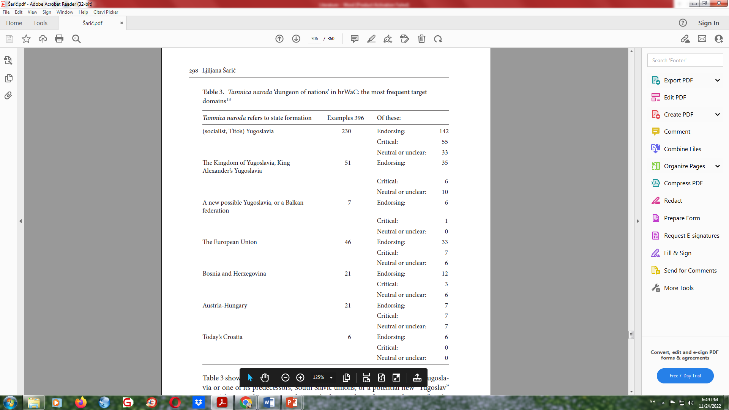
hrWaC corpus: target domains and context types

Slide 35
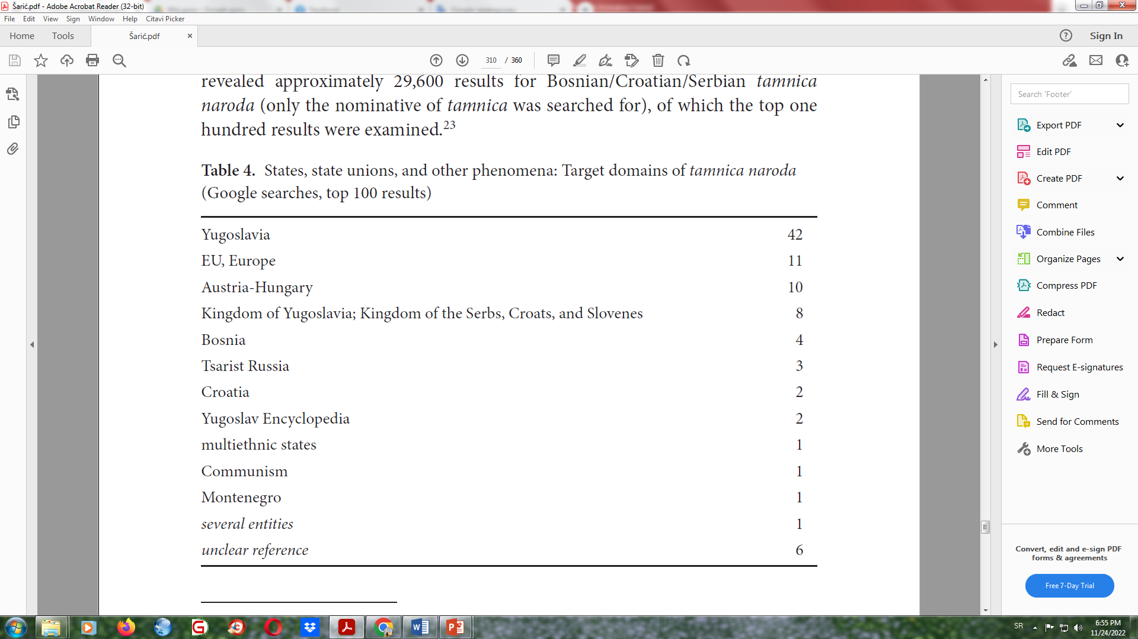
Google search: broader context

Slide 36
Some specific features of the metaphor’s use
(positively connoted)
Ali, ako [Hrvatska] ostane ovako provincijalno zatarabana i pubertetski
samozaljubljena, ukratko sterilna i dosadna, onda je, brate, bolje živjeti i
u grješnim, ali sto puta maštovitijim i zanimljivijim „tamnicama naroda,”
kojih god boja, austro-ugarsko-jugoslavensko-natovskih, one bile.25
(Forum.vidi.hr 08/12/2006)
But, if [Croatia] stays provincial and closed in immature self-infatuation, in short sterile and boring, then, brother, it is better to live in a sinful but hundred times more imaginative and interesting “dungeons of nations,” no matter their colours: Austro-Hungarian, Yugoslav, or NATO.
(metaphor instead of the real name - ironically)
Čuo sam da je jednom imala koncert za vrijeme tamnice naroda u Imoti. (IMOart Forum Croaticum 12/12/2010)
I heard that once, at the time of the dungeon of nations, she had a concert in Imota.
(literal meaning)
Nemojmo zaboraviti ni one tisuće zatočene po jugokomunističkom režimu u tamnice, kao što je i čitav narod bio zatočen u jednu veliku tamnicu naroda Jugoslaviju. (Hrvatski politički uznici 10/04/2009)
Let us not forget those thousands detained by the communist regime in dungeons, as the entire nation was held in the huge dungeon of peoples of Yugoslavia.

Slide 37
The functions of the prison of nations metaphor
The metaphor’s chief function in hrWaC is one of negatively evaluating political systems and states.
Specific additional functions – persuading participants in communicative events, delegitimizing groups or individuals, and reinforcing a relationship of solidarity among contributors.
In its chief function, the metaphor is used in the verbal expression of everyday nationalism, that is, creating an association with a certain nation or state by disassociating oneself from another nation or state, the metaphor’s target.
    The metaphor seems to be an important device in enacting nationhood, and, in the contexts in which it refers to Yugoslavia as the target domain, it perhaps indicates that Nation-building strategies in Croatia have been successful (see Kolsto 2014) in the sense that the majority of users strongly disassociate themselves from the former Yugoslavia and express their association with, and positive emotional attitude to, Croatia.

Slide 38
The dungeon of nations as a strategically-used evaluative metaphor in nation-building: Discussion and conclusion
However, instead of recontextualizing it in a creative manner, the majority of the examples in the data simply recycle the metaphor. The metaphor is thus rather “static.”
If one recalls the origin of this metaphor in a specific Slavic context, the corpus examined shows that the metaphor has broadened its usage range: it applies to many states of complex structure involving several nationalities. It also applies to organizations (e.g., EU and NATO) and major ideologies (e.g. communism).
The metaphor’s evaluative force is stable; it is constantly negative, which also makes the metaphor static in this respect. The social actors engaged in evaluation are occasionally journalists and political analysts, but the majority are anonymous or named participants in semi-official and official discourse.
A large number of sources that use and/or quote the prison of nations metaphor are right-wing, conservative sources. On the one hand, these sources continue the Croatian discourse of the 1990s (historiographic and political), and, on the other hand, they align with some recent European right-wing discourse concerning the EU: the metaphor prison of peoples has been part of recent discussions regarding the EU and Brexit.
The metaphor is a shared resource for enacting everyday nationalism.

Slide 39
References
Billig, Michael. 1995. Banal Nationalism. London, Thousand Oaks, and New Delhi: Sage
Cameron, Lynne. 2003. Metaphor in Educational Discourse. London and New York: Continuum.
Cammaerts, Bart. 2012. “The Strategic Use of Metaphors by Political and Media Elites: The 2007–11 Belgian Constitutional Crisis.” International Journal of Media & Cultural Politics 8(2/3): 229–249. https://doi.org/10.1386/macp.8.2-3.229_1
Charteris-Black, Jonathan. 2014. Analysing Political Speeches: Rhetoric, Discourse and Metaphor. Basingstoke and New York: Palgrave Macmillan. https://doi.org/10.1007/978-1-137-36833-1
Curtis, Benjamin. 2013. The Habsburgs: The History of a Dynasty. London: Bloomsbury.
De Custine, Marquis Astolphe. 2001. Journey for Our Time: The Journals of the Marquis de Custine, Russia 1839, ed. and trans. by Phyllis Penn Kohler. London: Phoenix Press.
Deignan, Alice. 2010. “The Evaluative Properties of Metaphors.” In Researching and Applying Metaphor in the Real World, ed. by Graham Low, et al, 357–374. Amsterdam: John Benjamins Publishing Company. https://doi.org/10.1075/hcp.26.21dei
Fox, Jon E., and Cynthia Miller-Idriss. 2008. “Everyday Nationhood.” Ethnicities 8(4): 536–563; https://doi.org/10.1177/1468796808088925
Gavriely-Nuri, Dalia. 2013. The Normalization of War in Israeli Discourse, 1967–2008. Lanham: Lexington Books.
Kolsto, Pal (ed.). 2014. Strategies of Symbolic Nation-Building in South Eastern Europe. London and New York: Routledge.

Slide 40
References
Lakoff, George, and Mark Johnson. 1980. Metaphors We Live By. Chicago: The University of Chicago Press.
Lenin, Vladimir Il'ch. 1976. Sbornik proizvedenij. Moskva: Politizdat.
Le Pen, Marine. 2016. “After Brexit, the People’s Spring is Inevitable.” The New York Times, 28 June. http://www.nytimes.com/2016/06/28/opinion/marine-le-pen-after-brexit-the-peoples-spring-is-inevitable.html?_r=0.
Semino, Elena, Alice Deignan, and Jeannette Littlemore. 2013. “Metaphor, Genre, and Recontextualization.” Metaphor and Symbol 28 (1): 41–59. https://doi.org/10.1080/10926488.2013.742842
Steen, Gerard. 2008. “When is Metaphor Deliberate?” In Selected Papers from the Stockholm 2008 Metaphor Festival, ed. by Nils-Lennart Johannesson, Christina Alm-Arvius, and David C. Minugh, 43-63. Stockholm University Press.
Vasilév, Aleksandr Dmitrievič. 2013. “Zagraničnye istiny: svobodnyj mir vs tjur’ma narodov.” Političeskaja lingvistika 3 (45): 12–21.
Zinken, Jörg, Iina Hellsten, and Brigitte Nerlich. 2007. “Discourse Metaphors.” In Body, Language, and Mind. Vol. 2: Sociocultural Situatedness, ed. by Roslyn M. Frank, René Dirven, Tom Ziemke, and Enrique Bernárdez, 363–385. Berlin: Mouton.
Corpus
hrWaC v2.2 (Croatian Web Corpus). http://nl.ijs.si/noske/all.cgi/first_form?corpname=hrwac;align=.

